Slide 1
Sweta Chowdhury’s Project
Topic : Power BI
Tools Used : MS Excel & PowerBi Desktop

Slide 2
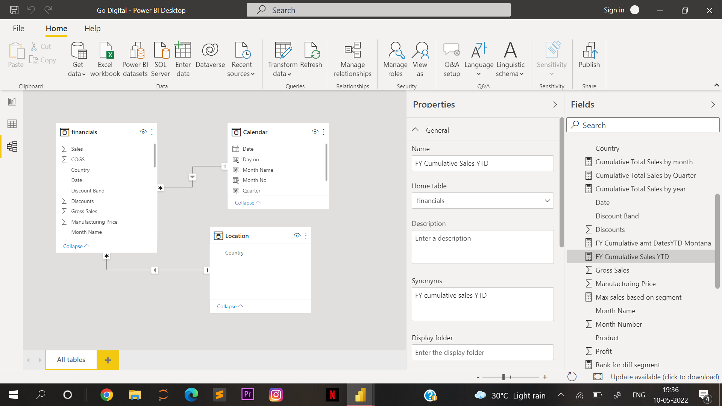
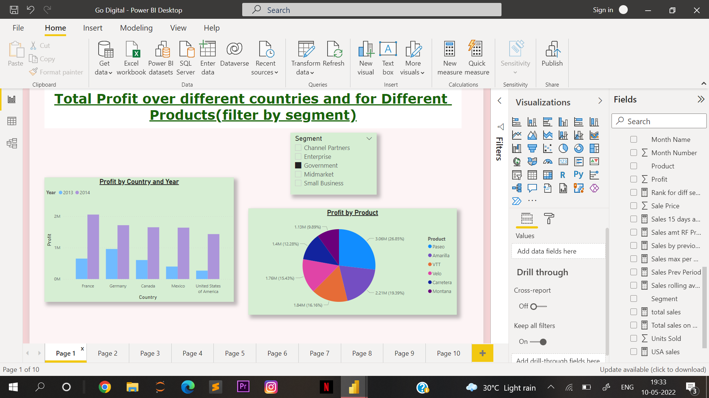
Relationship model

Slide 3
Questions :
What is the total profit amount across different Country?
What is the total profit amount for different products?
Filter the above result based on Different Segment
Answer →

Slide 5
Questions :
4. What is the total sales amount across different Country?
5. What is the total sales amount for different products?
6. Filter the above result based on Different Discount Band.
7. Apply Conditional Formatting in case of Profit amount for different Segment , also show Sales and Gross Sales.
Answer →

Slide 6
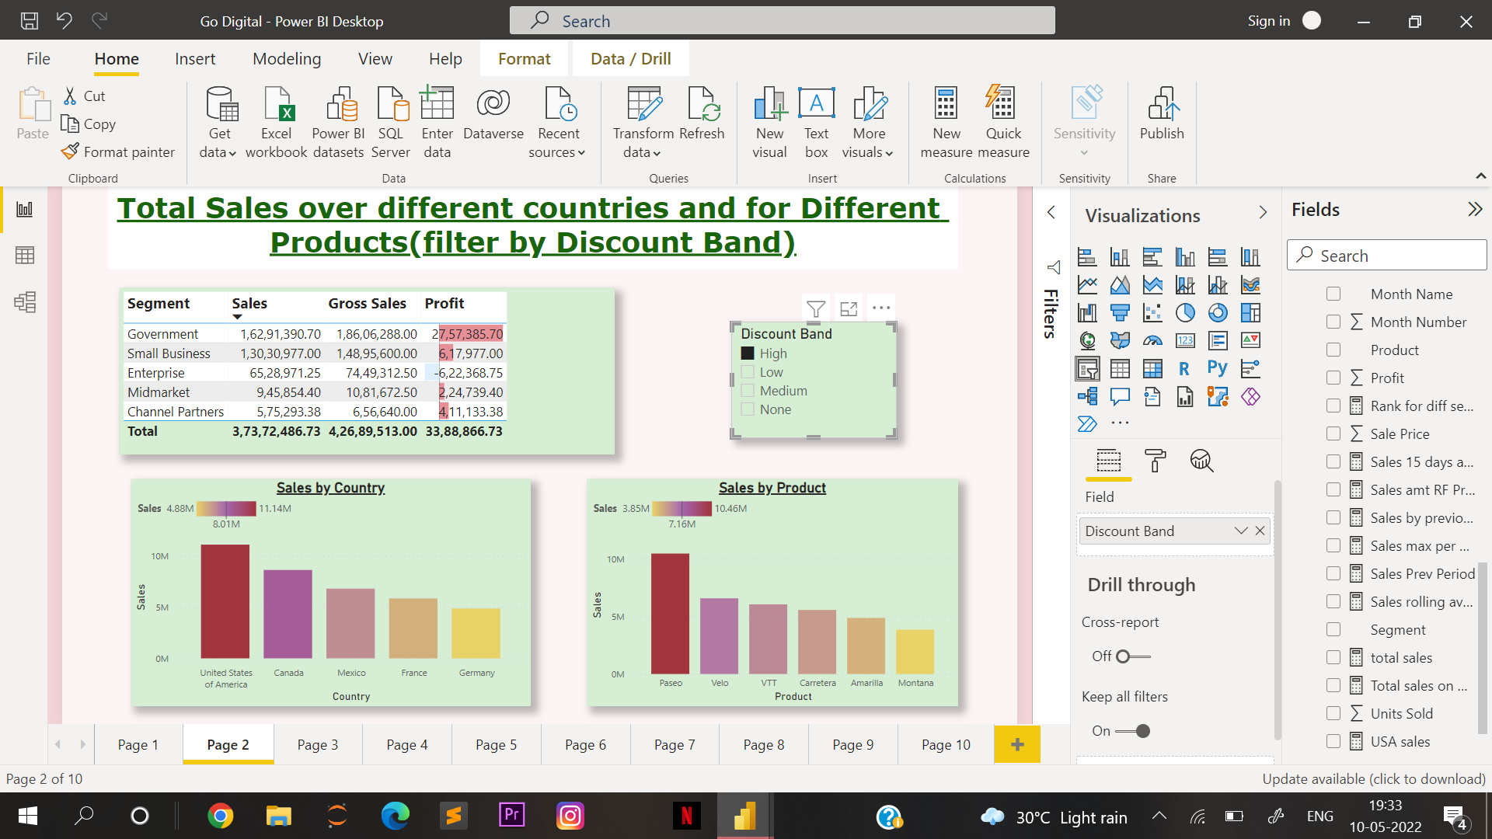

Slide 7
Questions :
8. Display Cumulative sales amount for month, quarter and Year.
9. Show the change in sales and cumulative sales for a year.
Answer →

Slide 8
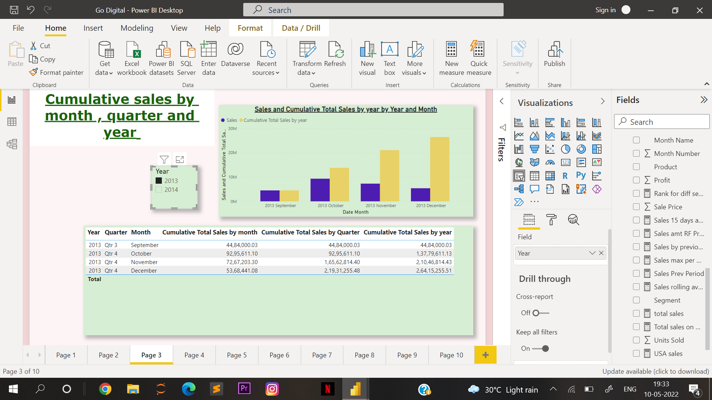

Slide 9
Questions :
10. What is the total sales and sales 15 days ago?
11. Display the total sales for every month and corresponding previous month.
12. Compare the Last Year sales to this year sales by Month.
Answer →

Slide 10
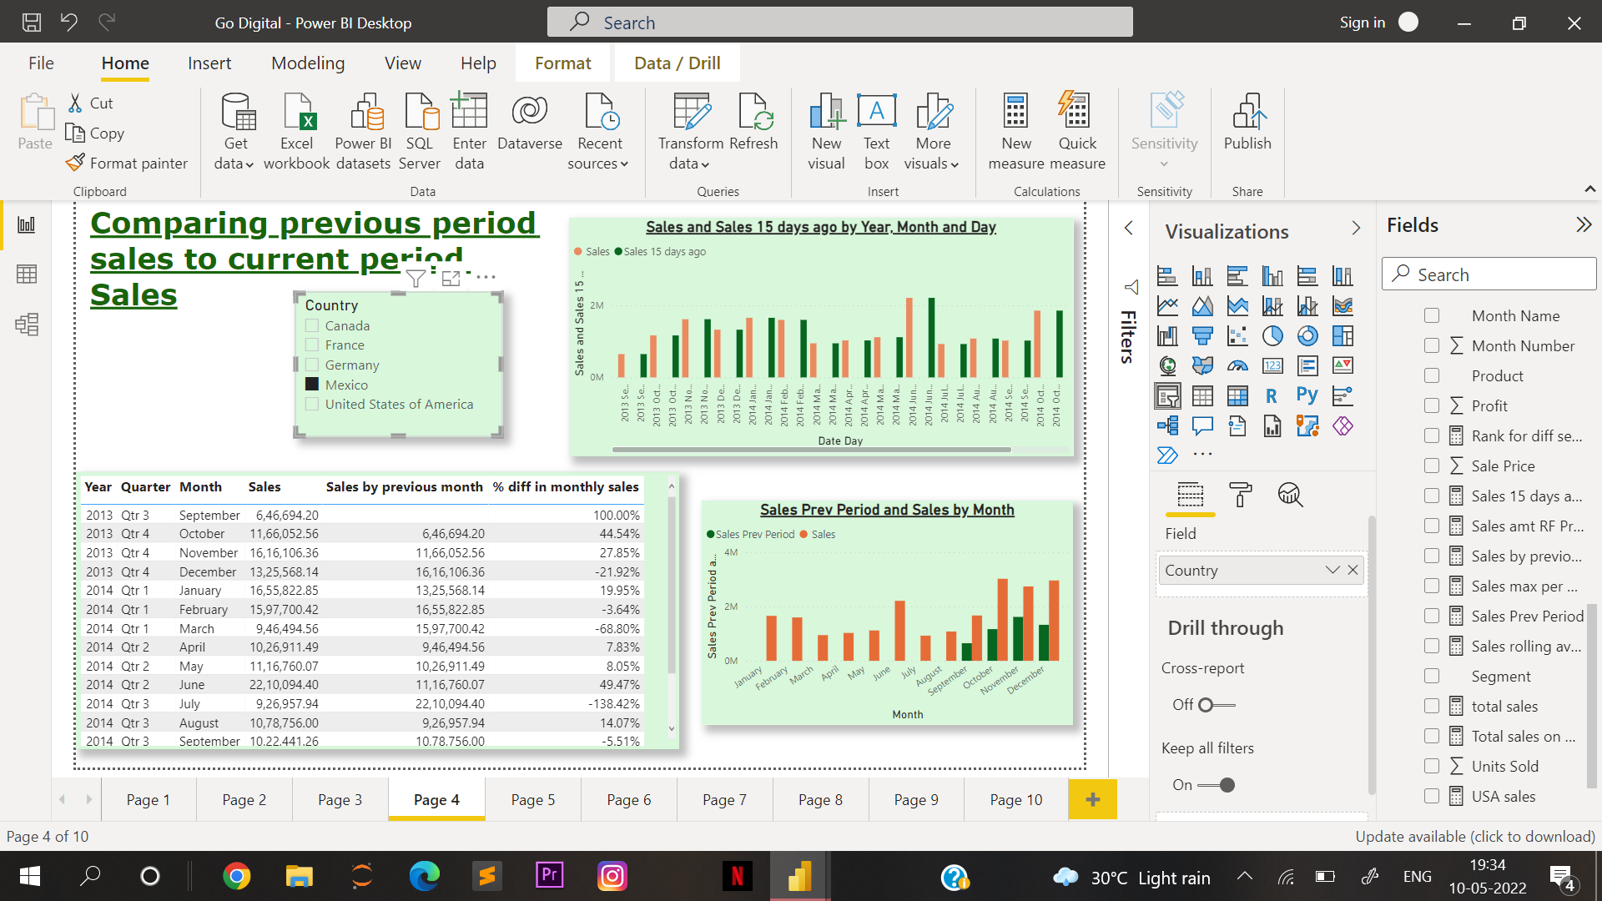

Slide 11
Questions :
13. Display ALL sales.
14. Display ALL sales except Countries.
15. Filter the above result based on Different Segment ,Country, Product and Month.
Answer →

Slide 12
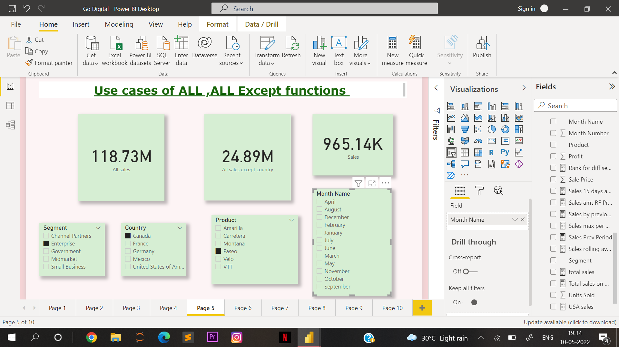

Slide 13
Questions :
16. How to calculate rolling average sales?
17. Want to see the Ranking of different countries’ sales based on different segment.
18. Calculate sales happening on only weekdays.
Answer →

Slide 14
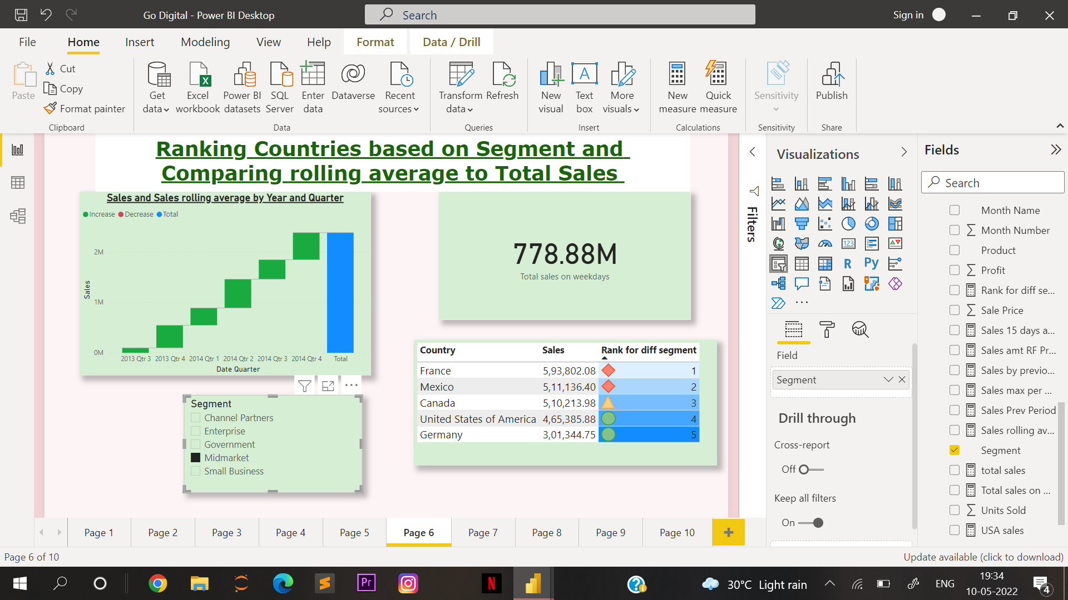

Slide 15
Questions :
19. Calculate total sales and percentage change in sales to all sales.
20. Filter the above result based on Different Segment and Countries
Answer →

Slide 16
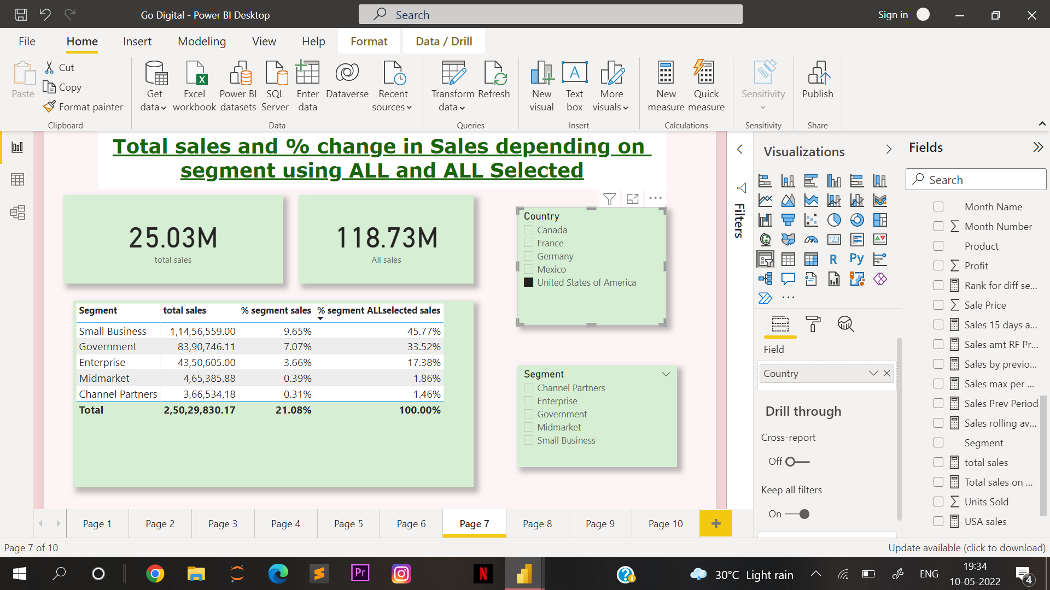

Slide 17
Questions :
21. Implement drillthrough based on Product
Answer →

Slide 18
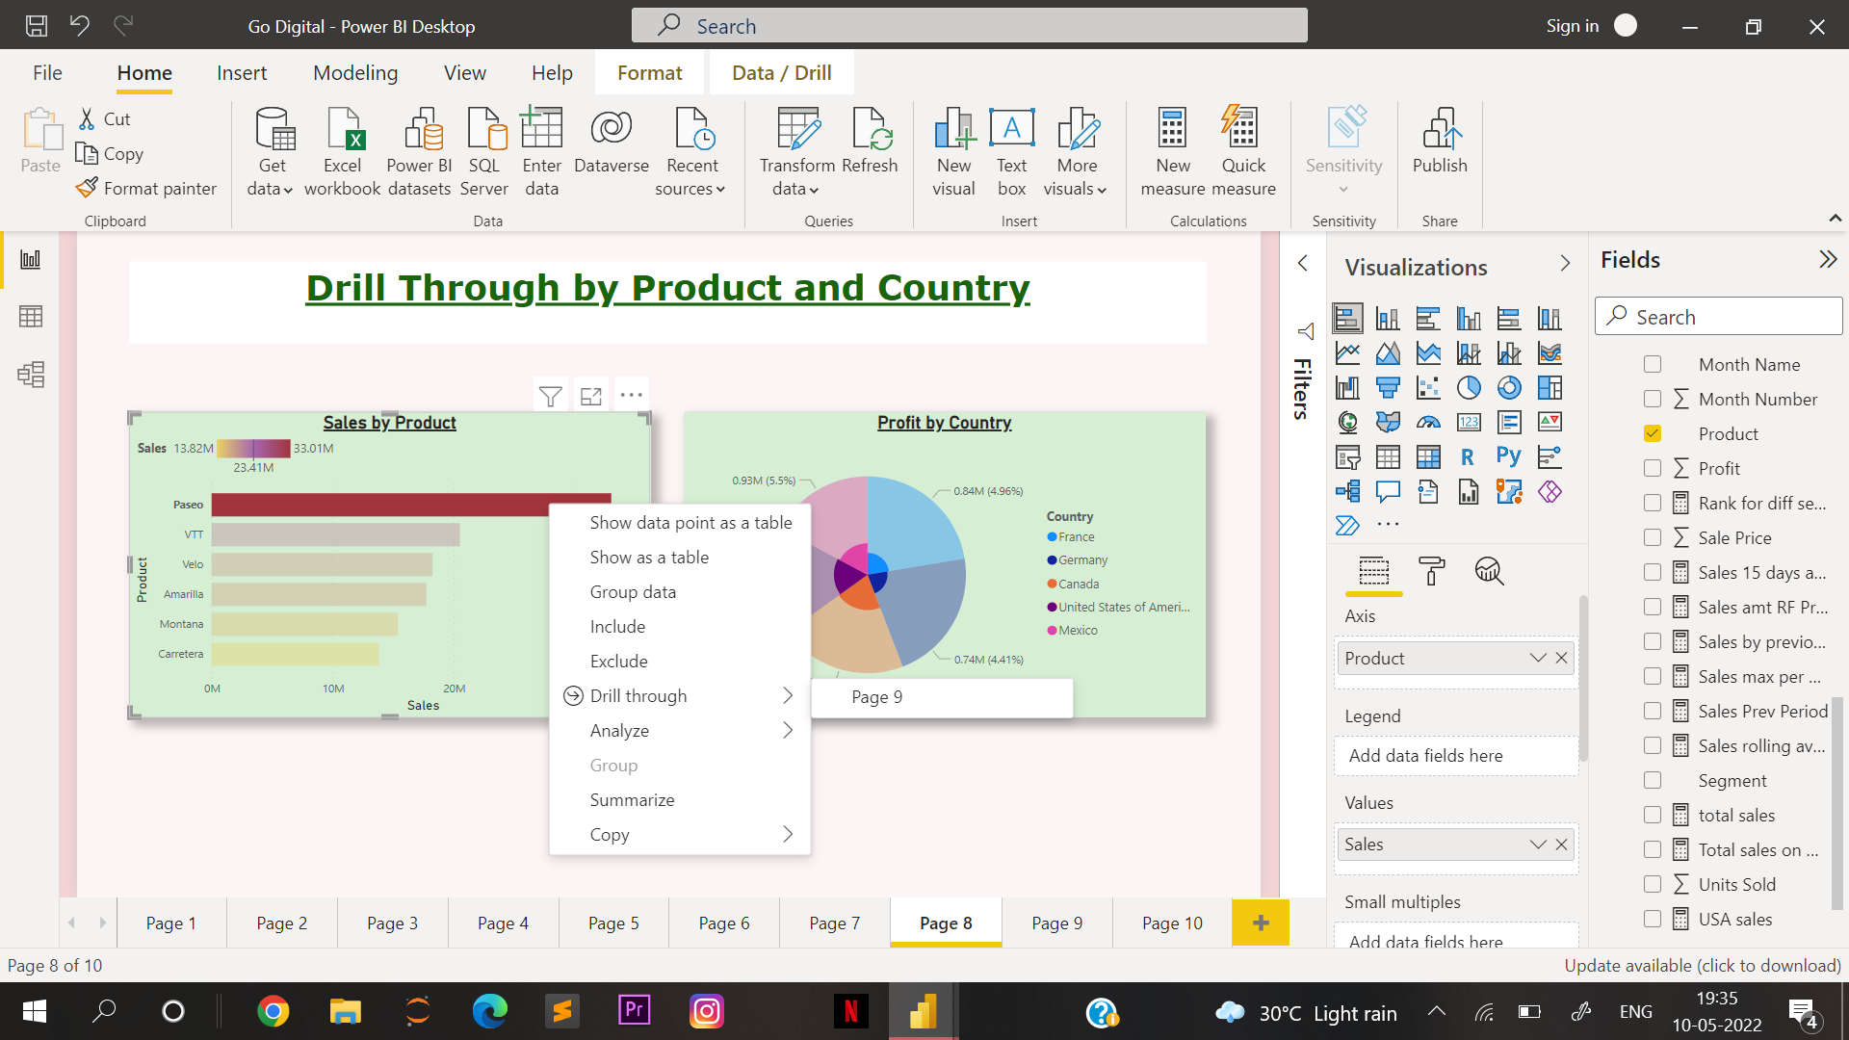

Slide 19
Questions :
22. Implement drillthrough based on country.
Answer →

Slide 20
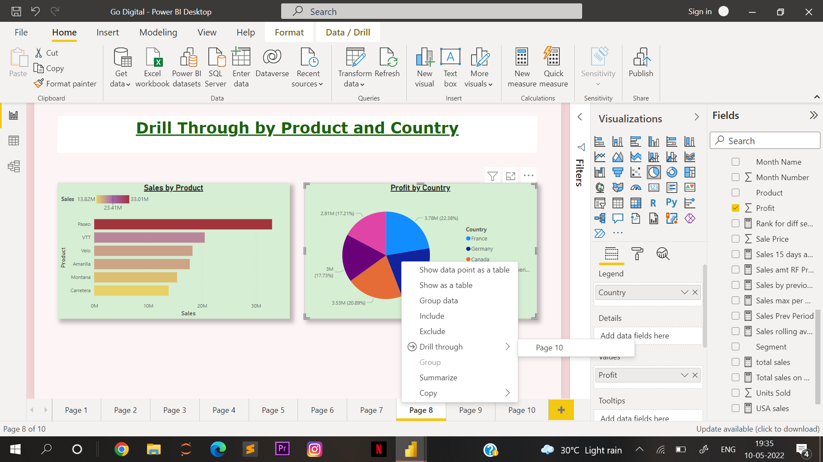

Slide 21
Questions :
23. What is the change in sales by drilling through product?
24. What is the max sales per country?
25. What is the max sales per country for Government Segment?
Answer →

Slide 22
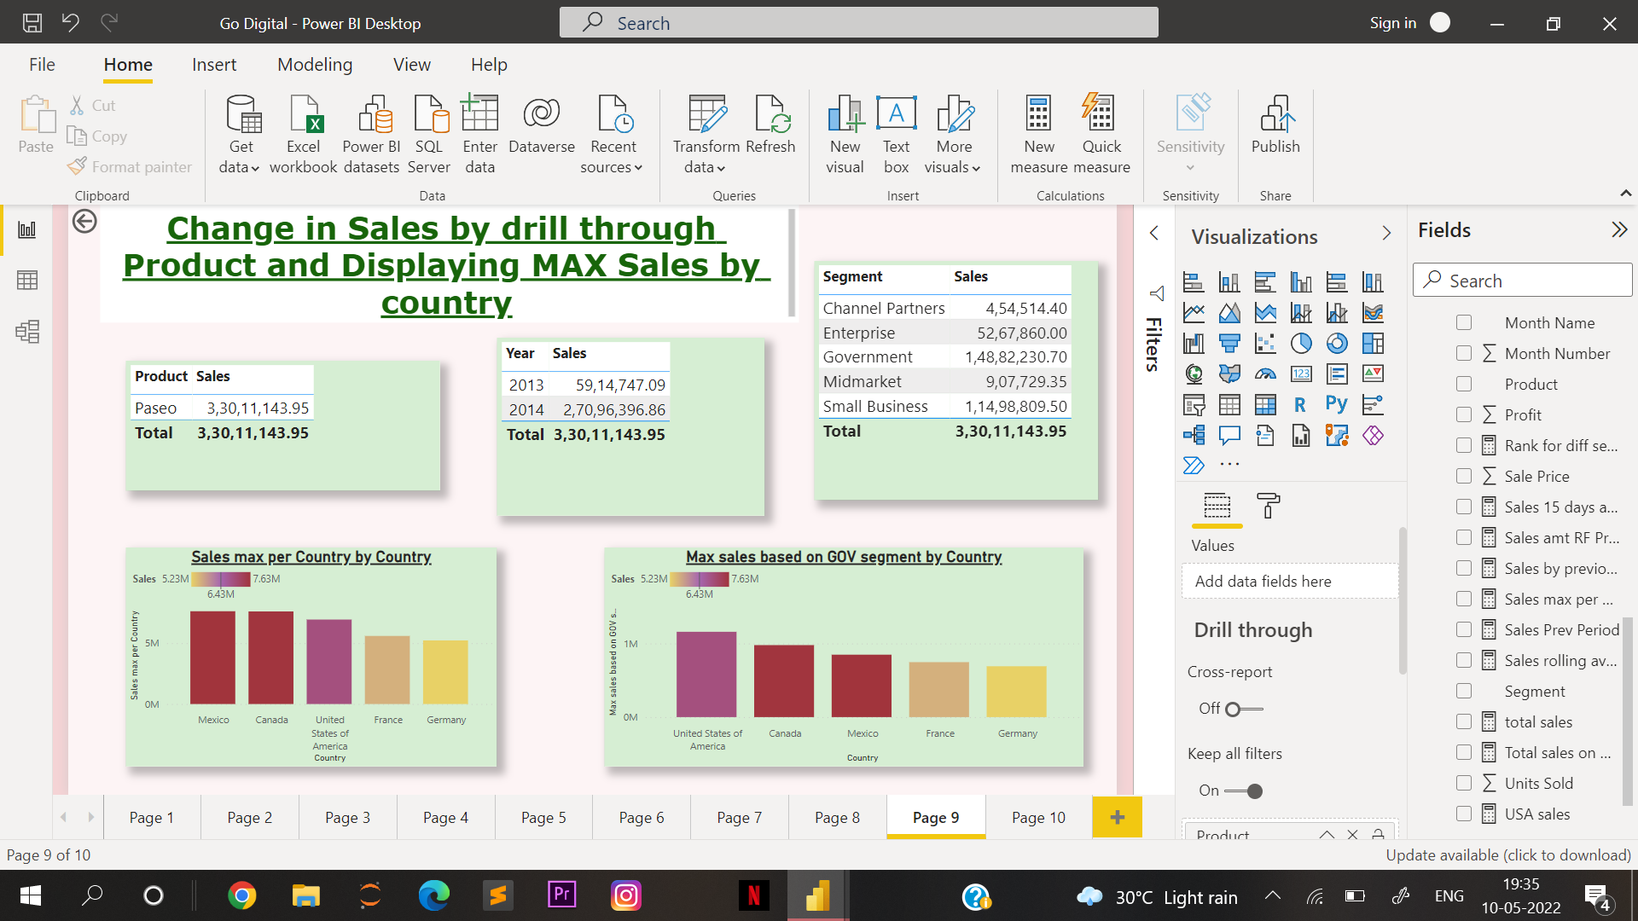

Slide 23
Questions :
23. What is the change in sales by drilling through country?
24. What is the financial year cumulative sales?
25. Show the financial year cumulative sales for the product “Montana”.
Answer →

Slide 24
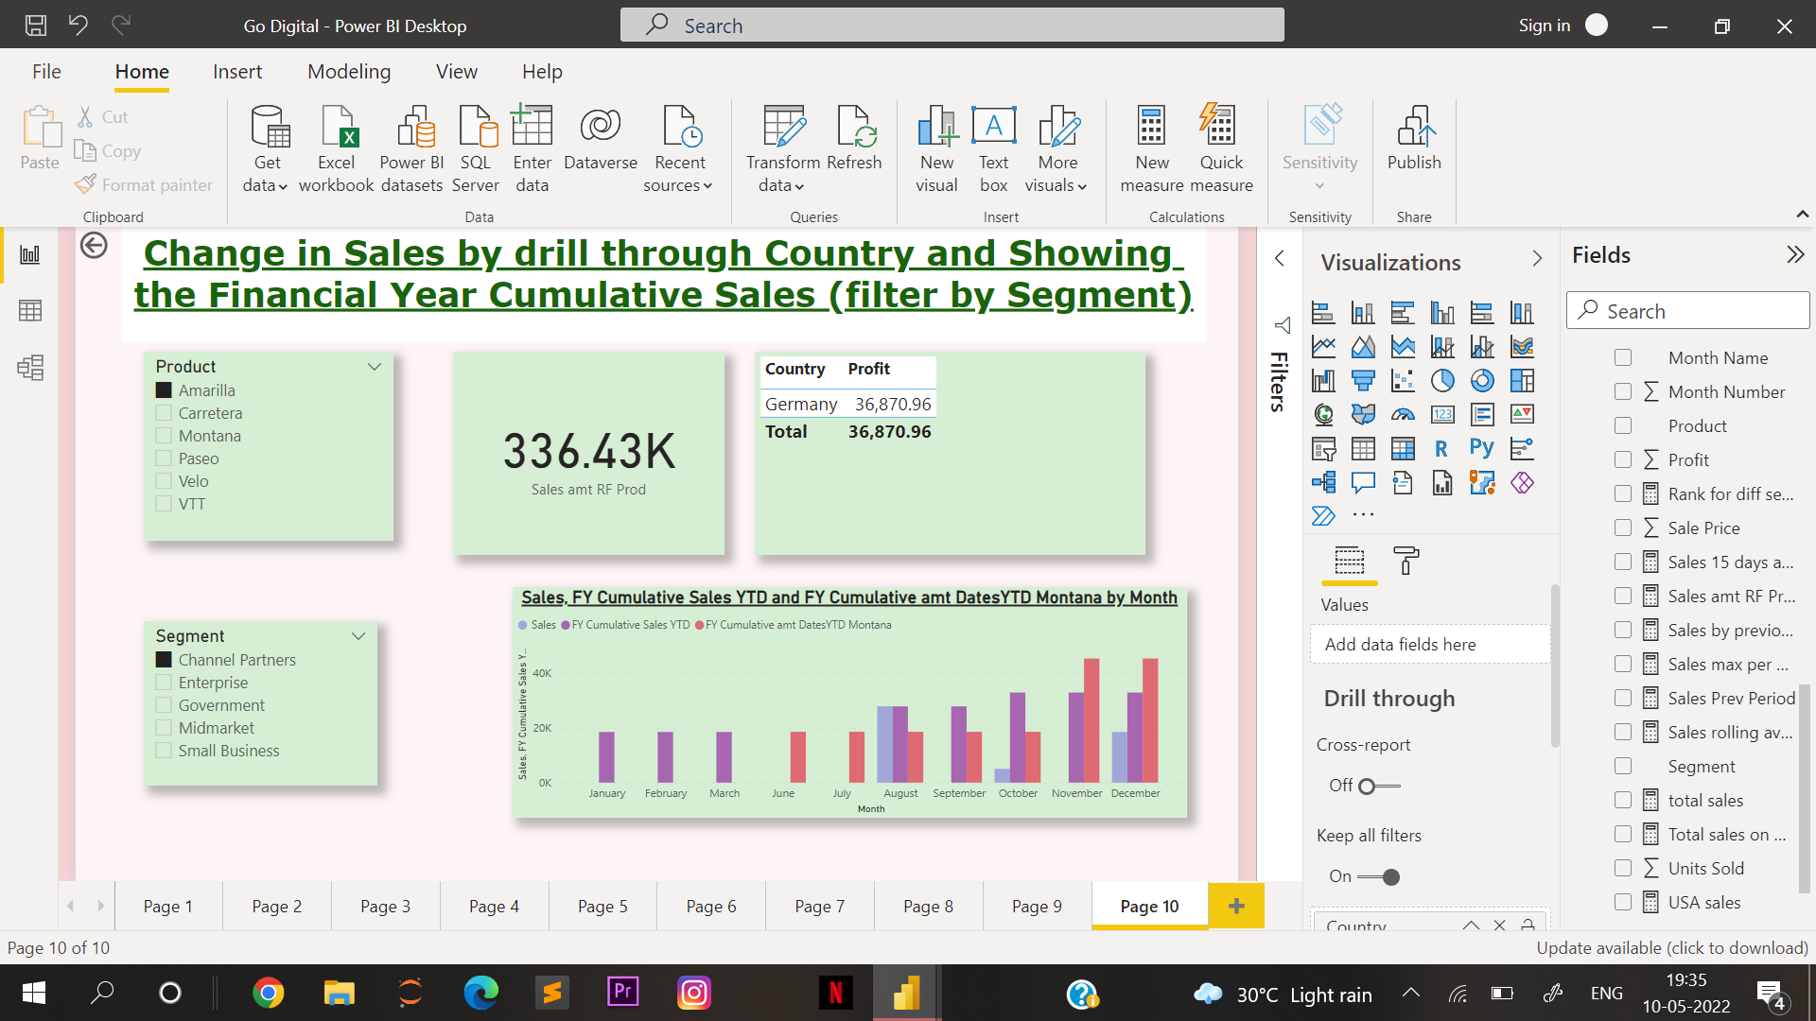

Slide 25
Thanks & Regards,
Sweta Chowdhury

